Slide 1
DWBI PROJECT
GROUP 5
TRENDS FOLLOWED BY PROVIDERS IN SPENDING ON CLAIMS & DRUG UTILIZATION
- Yarshil Shah
Amit Shivakumar
Neel Lele
Prajwal Parlawar

Slide 2
INTRODUCTION
The United States spends more on health care than any other country in the world, about twice the average among developed countries. The United States spent about $3.5 trillion or about 18 percent of the GDP on health care. The Open Payments program is a statutorily-required, national disclosure program that promotes transparency and accountability by making information about the financial relationships between applicable manufacturers and Group Purchasing Organizations (GPOs) who are required to report payments or transfers of value to covered recipients under the Physician Payment Sunshine Act and physicians to the public.
The Physician Payments Sunshine Act requires medical product manufacturers to disclose to the Centers for Medicare and Medicaid Services (CMS) any payments or other transfers of value made to physicians or teaching hospitals.
The data sets used for this project are The Drug spending data, Open Payments data and the Physician and other supplier job.

Slide 3


Slide 4
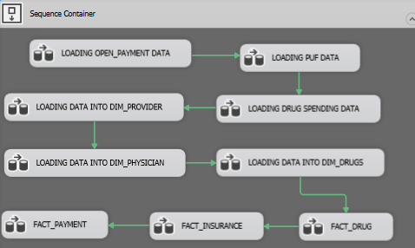
PROJECT DESIGN
Clean your Data, folks
Archive Tables- nobody cares but important
PEOPLE!!! Staging Table should not be your Raw Data, come on!!
Know your Foreign Key Constraints
You need to have distinct data in your Dimension Tables, SHU thank you!
Use Sort, Merge & Lookup Because -Grades

Slide 5
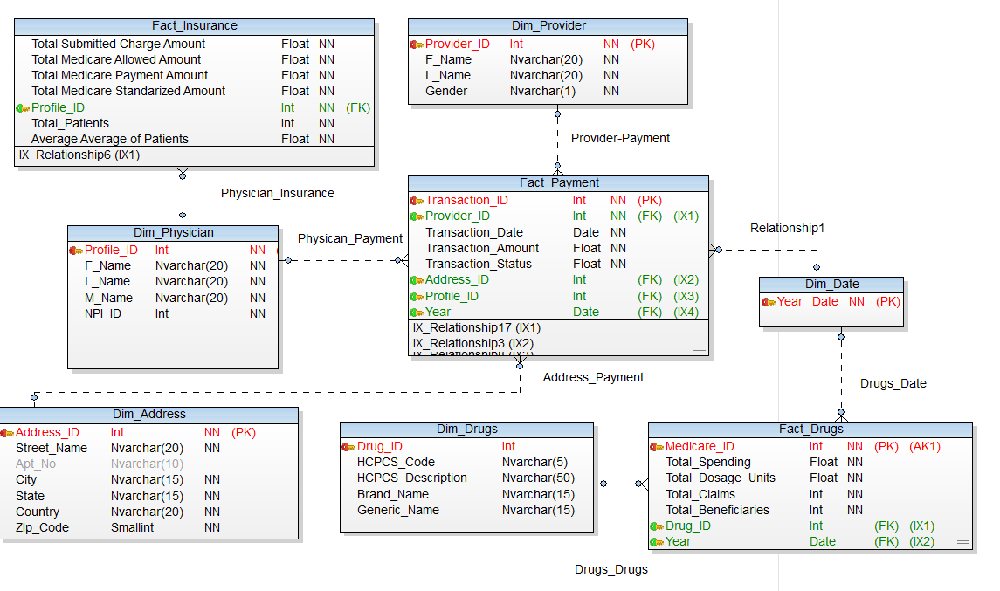
DIMENSIONS, FACTS & CUBES
Dim_Physician(conformed) - Obviously Physician’s Data
Dim_Provider - Details of the Provider DUH!!
Dim_Address - Address of Provider and Physician
Dim_Drugs - Interesting Details about Drugs and Utilization (real stuff)
Dim_Year- We just had two years so nothing much
there so, next
Fact_Payment - Covers the Transactional Data
between the physician- provider- third party
Fact_Insurance - everyone wants cashbacks
Fact_Drugs - Well usage of Dosage, Spending, Patients

Slide 6
CONCLUSION
In most cases the claims for Drugs are increasing from 2015 to 2016 for all drug companies which means an increase in Drug usage overall by beneficiaries. This can be interpreted as an increase in the amount of people receiving healthcare coverage on a yearly basis.
States with a population where the population has more “deadly” diseases tend to have higher medicare claim values. This is because the Drugs used for the treatment of these diseases cost a lot more.
Such practical examples as well as the study of data warehouse architecture and reporting capabilities, show the advantages of implementing a Data Warehouse for an improved experience for users who are querying and reporting on data for better-informed decisions.
Insulin as we talked about earlier in the Hasan Minhaj slide is one of those medicines used to treat Diabetes has its price increasing from year to year. Like insulin the price for other essential drugs and medicines are also increasing. With the increase in the drug price the claim values by beneficiaries to the insurance providers and payments made to the physicians by these manufactures is also increasing.

Slide 7


Slide 8


